Slide 1
Covid Death Rate Analysis

Slide 2
Team 5
Name | Section | BN
Andrew Boshra | 1 | 17
Peter Micheal | 1 | 21
Taher Mohamed Ahmed | 1 | 37
Omar Mohamed Ahmed | 2 | 6

Slide 3
TABLE OF CONTENTS
01
02
Problem Statement
Project Pipeline
03
04
Analysis and Solution of the Problem
Observations and Insights
05
Model Training and Evaluation
06
Unsuccessful Trials & ﻿Future Work

Slide 4
01
Problem Statement

Slide 5
Problem Statement
This project aims to determine the mortality status of patients, whether they have passed away or are still alive, in the context of the COVID-19 pandemic. The project utilizes a coronavirus dataset to classify patients based on their symptoms and investigates the association rules between these symptoms, other routines, and diseases. The main objective is to develop a predictive model that accurately identifies patients at risk of mortality and enables early interventions to mitigate the spread of the virus. Furthermore, the study of association rules aids in identifying the co-occurrence of symptoms and underlying diseases, facilitating early diagnosis and effective disease management.

Slide 6
02
Problem Statement

Slide 7
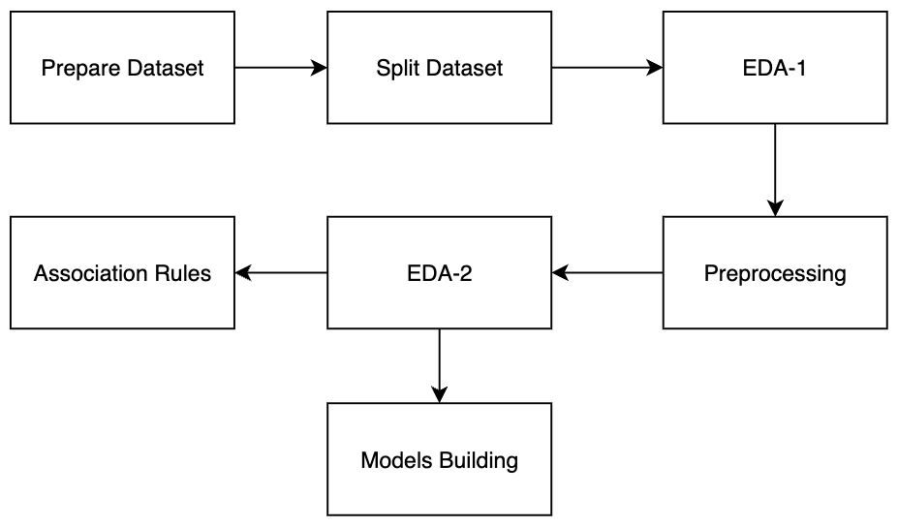
Project Pipeline

Slide 8
03
Analysis and Solution of the Problem

Slide 9
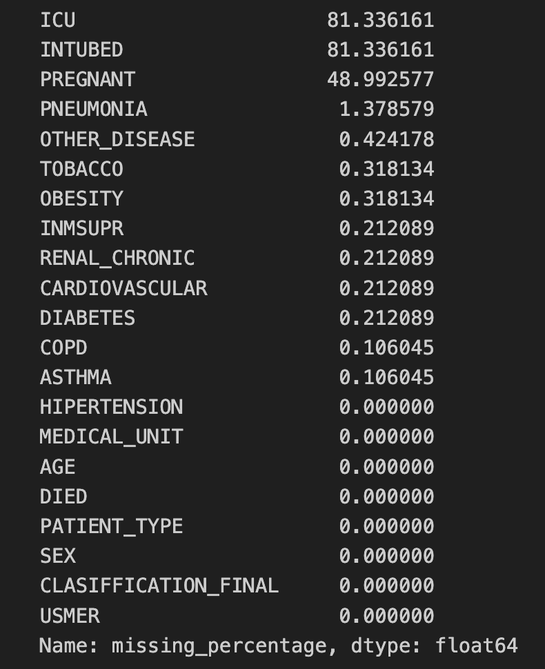
Analysis and Solution of the Problem
Prepare dataset
Convert the values 97,98, and 99 in the binary columns to nulls.
Convert the death date into a binary value to indicate whether the patient died or not.
Split dataset
Split the dataset into 80% train and 20% test.
EDA-1­­­­
In this step, we analyze the dataset before applying any preprocessing.
Check the percentage of the null value in each column

Slide 10
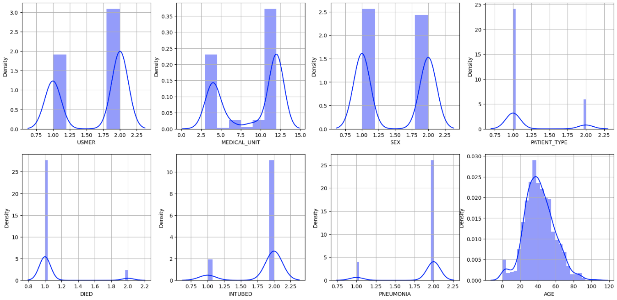
Analysis and Solution of the Problem
Get unique values for each column
Draw histograms to see the distribution of each feature.

Slide 11
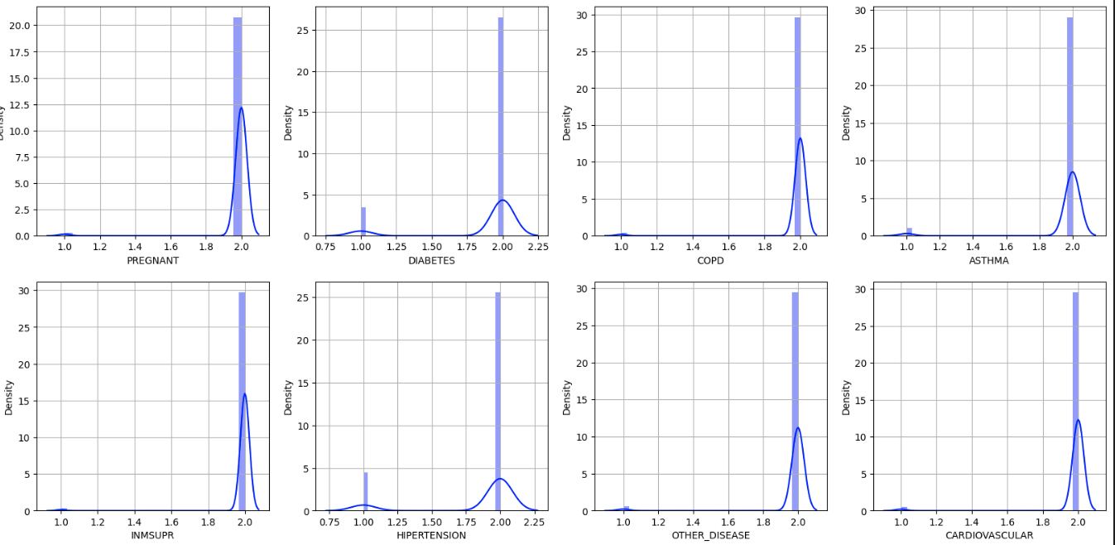
Analysis and Solution of the Problem

Slide 12
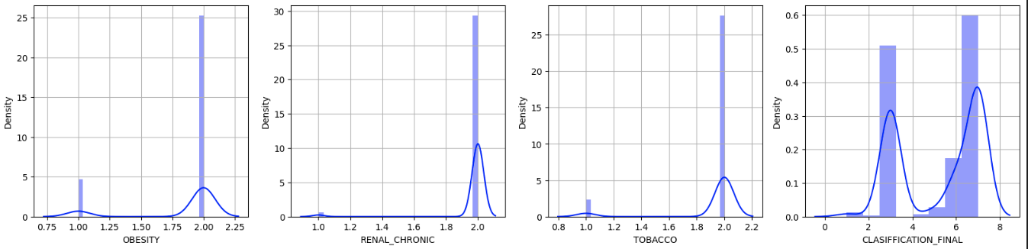
Analysis and Solution of the Problem

Slide 13
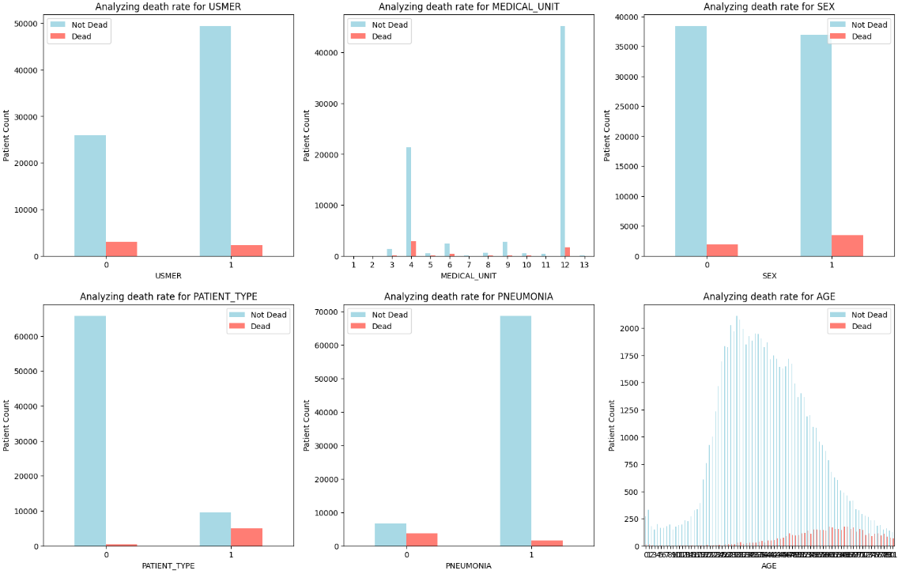
Analysis and Solution of the Problem
Draw the death value with each feature.

Slide 14
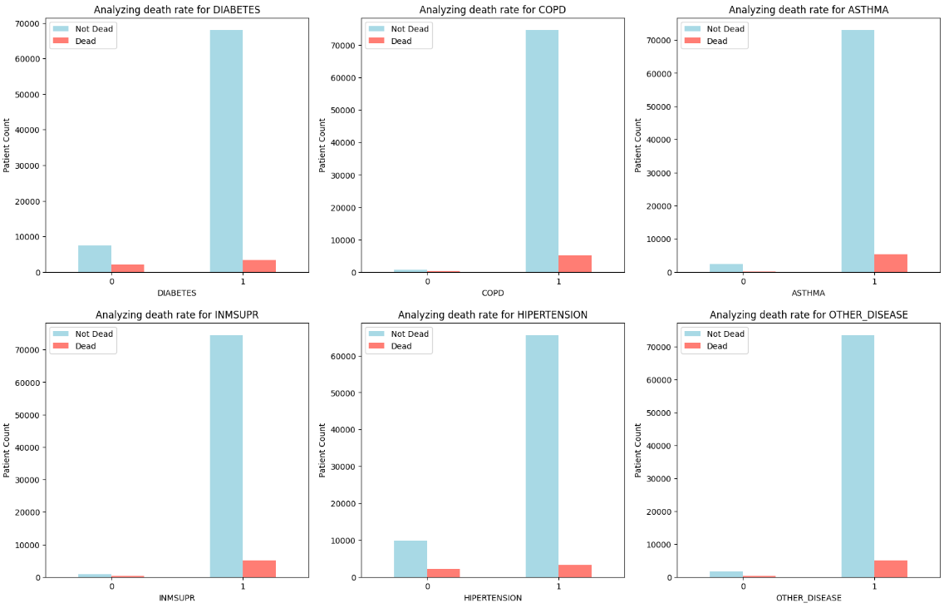
Analysis and Solution of the Problem

Slide 15
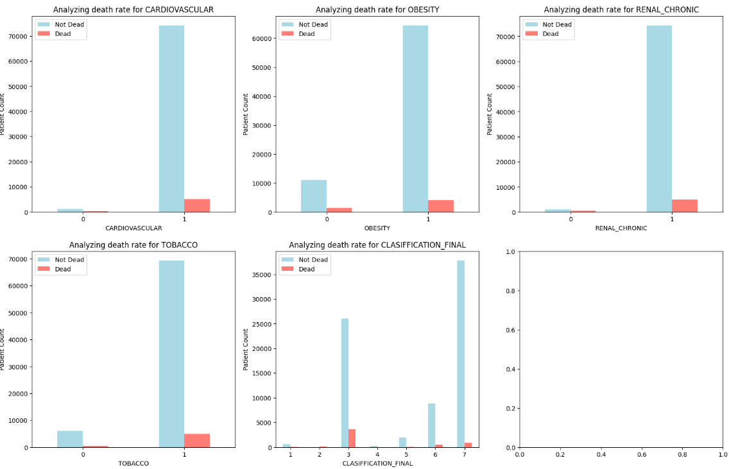
Analysis and Solution of the Problem

Slide 16
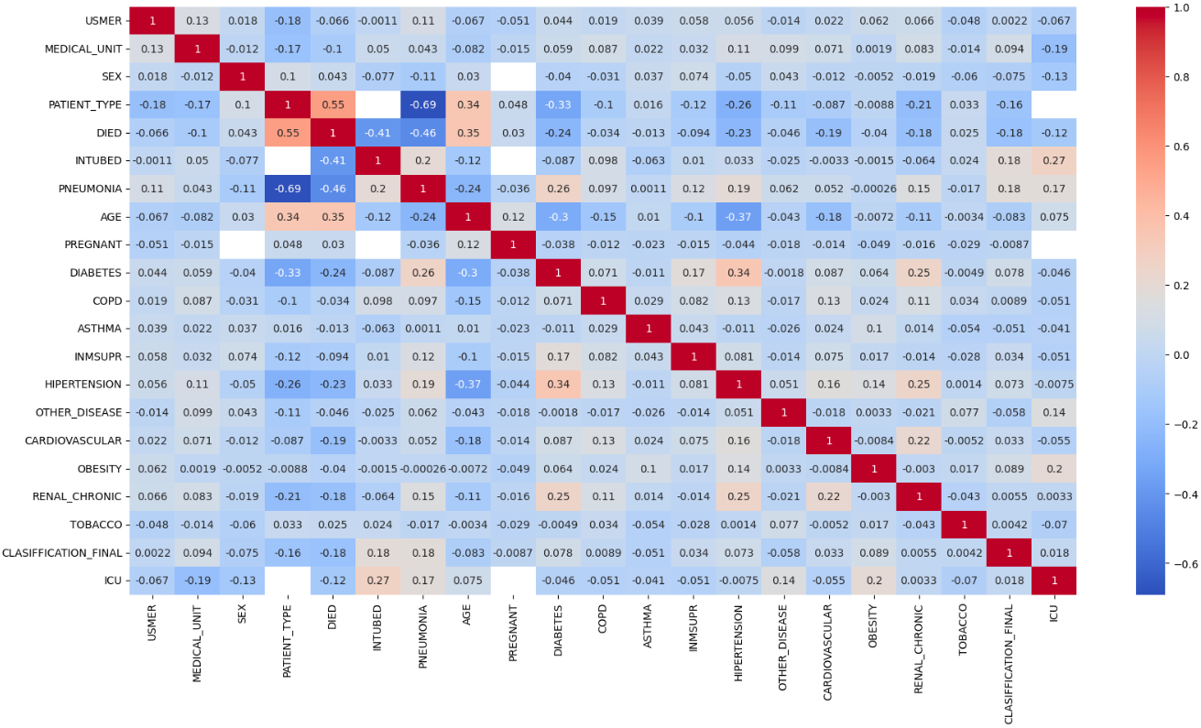
Analysis and Solution of the Problem
Get the correlation between each pair of features.

Slide 17
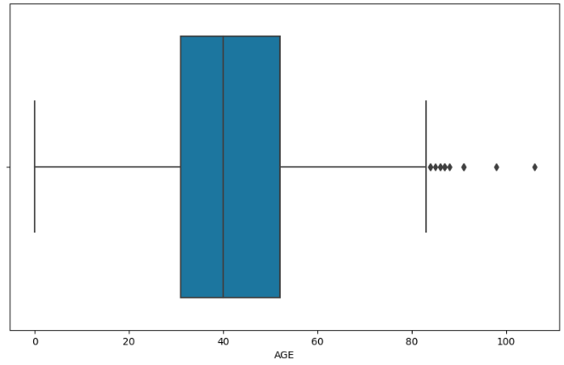
Analysis and Solution of the Problem
Detect outliers in numerical columns (Age)

Slide 18
Analysis and Solution of the Problem
Preprocessing
Drop columns that have high missing values (ICU/ INTUBED / Pregnant)
Drop rows with null values
Remove age outliers
Convert Boolean columns to 0,1 instead of 1,2

Slide 19
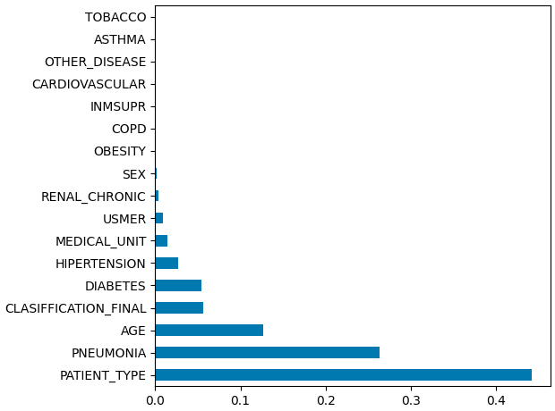
Analysis and Solution of the Problem
EDA-2
The same steps in EDA-1 were applied and the following are the new steps
Feature importance

Slide 20
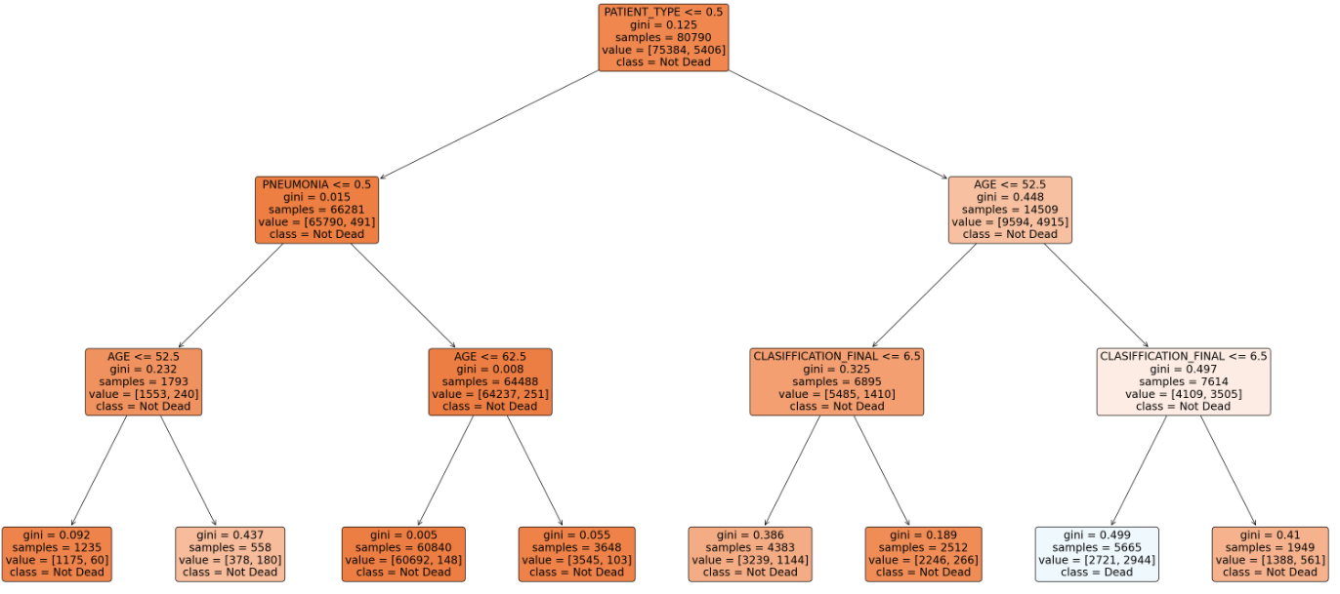
Analysis and Solution of the Problem
EDA-2
The same steps in EDA-1 were applied and the following are the new steps
Feature importance

Slide 21
Analysis and Solution of the Problem
Detect outliers in numerical columns (Age)

Slide 22
04
Observations and Insights

Slide 23
Observations and Insights
From EDA
There is a class imbalance in the data.
The ratio of patients having diabetes, asthma, and other diseases is very high compared to the normal averages.
People who have an infection with a classification value of 3 are more likely to die.
The death rate in males is higher than in females.
People who got admitted to intensive care have a lower death rate.
The death rate increases with the increase in age.
­Death is inversely correlated with diabetes and pneumonia.
Death is highly correlated with patient type which indicated that hospitalized patients are more likely to do. Being in the hospital not the home means that the case is at risk which gives a higher probability of death.
There is a good observation that indicates that there is an inverse correlation between age and hypertension.

Slide 24
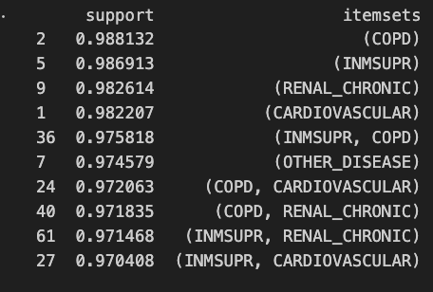
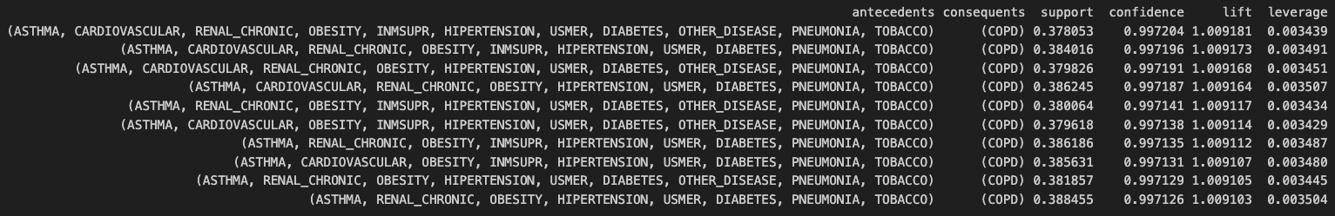
Observations and Insights

Slide 25
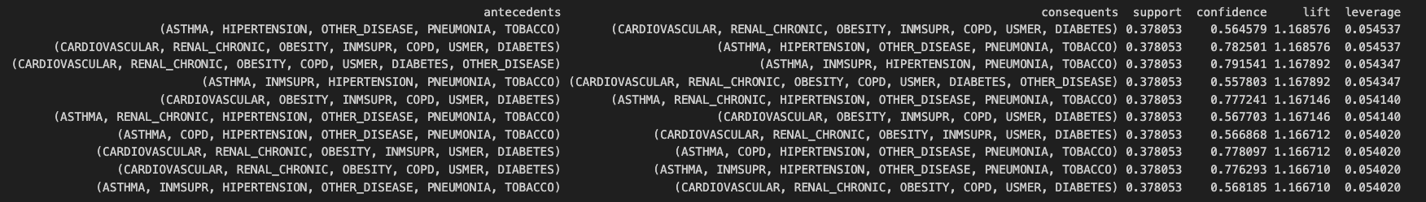
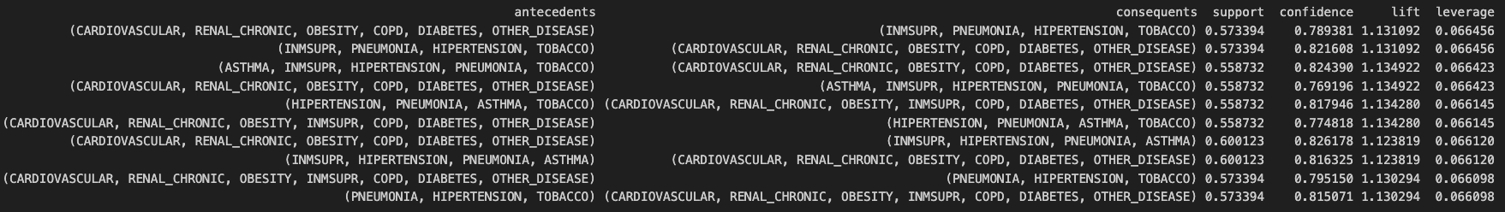
Observations and Insights

Slide 26
Observations and Insights
From EDA
There is a class imbalance in the data.
The ratio of patients having diabetes, asthma, and other diseases is very high compared to the normal averages.
People who have an infection with a classification value of 3 are more likely to die.
The death rate in males is higher than in females.
People who got admitted to intensive care have a lower death rate.
The death rate increases with the increase in age.
­Death is inversely correlated with diabetes and pneumonia.
Death is highly correlated with patient type which indicated that hospitalized patients are more likely to do. Being in the hospital not the home means that the case is at risk which gives a higher probability of death.
There is a good observation that indicates that there is an inverse correlation between age and hypertension.

Slide 27
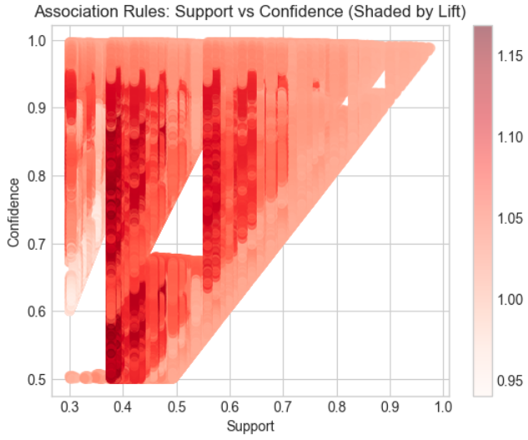
Observations and Insights

Slide 28
05
Model Training and Evaluation

Slide 29
 | Dataset | Accuracy | Weighted Precision | Weighted Recall | Weighted F1
Logistic Regression | Train | 0.941 | 0.933 | 0.941 | 0.935
 | Test | 0.941 | 0.932 | 0.941 | 0.935
Random Forest | Train | 0.941 | 0.928 | 0.941 | 0.929
 | Train | 0.939 | 0.926 | 0.939 | 0.927
Decision Trees | Train | 0.94 | 0.927 | 0.94 | 0.927
 | Test | 0.939 | 0.926 | 0.939 | 0.925
Naïve Bayes (map-reduce) | Train | 0.921 | 0.945 | 0.921 | 0.93
 | Test | 0.922 | 0.944 | 0.922 | 0.93

Slide 30
06
Unsuccessful Trials & ﻿Future Work

Slide 31
Unsuccessful Trials
1. Impute the values of the three columns that have missing values of more than 40%. When using these columns, the model results were not good enough as the final models.
2. After Dropping these columns using the imputation for the missing values for other columns is not good as dropping null columns. We were able to drop null rows as the size of the data was large enough.
3. Before using feature, importance, and dropping unimportant columns the performance was lower than the final performance and this is justified by that there are so columns that are not correlated to the feature we are predicting.
4. Making the classification final feature a Boolean was no good idea, it is better to have a measure of how the patient is infected.

Slide 32
Future Work
Using other models
Try a neural network on this large number of rows
Do more feature engineering and try to define a feature that mixes two or more features to predict the results correctly.
Doing more data mining on the data.

Slide 33
Thanks

